Slide 1
PROJECT TITLE - SOLAR BASED SMART GRID WIREMAN SAFETY
CREATED BY – Mr. Pranav Laxman Sadafal.

Slide 2
CONTENTS
INTRODUCTION
COMPONENTS
BLOCK DIAGRAM OF PROJECT CIRCUIT
WORKING OF MODULE
RESULT
ADVANTAGES
DISADVANTAGES
APPLICATIONS
CONCLUSION

Slide 3
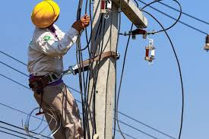
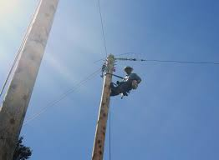
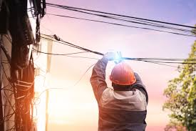
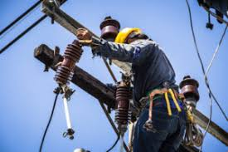
INTRODUCTION
FAULTS TAKING PLACE IN ELECTRICAL SYSTEM
CAUSES OF FAULTS
CORRECTING THE FAULTS
ACCIDENTS TAKING PLACE WHILE CORRECTING THESE FAULTS
CAUSES OF ACCIDENTS
IMPORTANCE OF THIS PROJECT IN AVOIDING THE ACCIDENTS
WHAT DOES THE PROJECT PROVIDE PROTECTION AGAINST ?

Slide 4
COMPONENTS
Step down Transformer
89S52 Microcontroller.
Voltage Regulator LM 7805.
LCD.
Buzzer.
Relay.
Solar plate
Crystal Oscillator.
sim900a GSM module
PCB Layout.

Slide 5
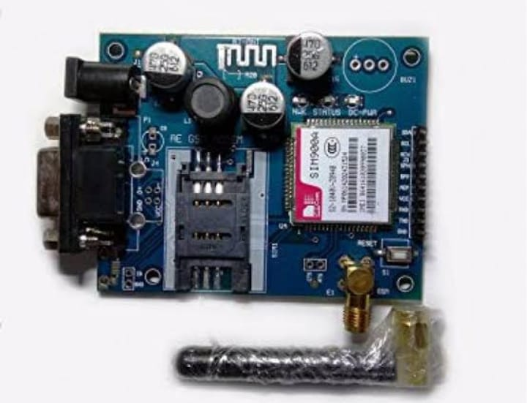
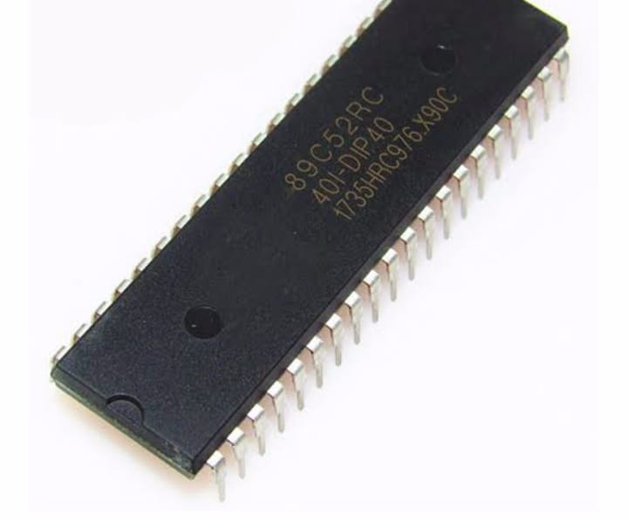
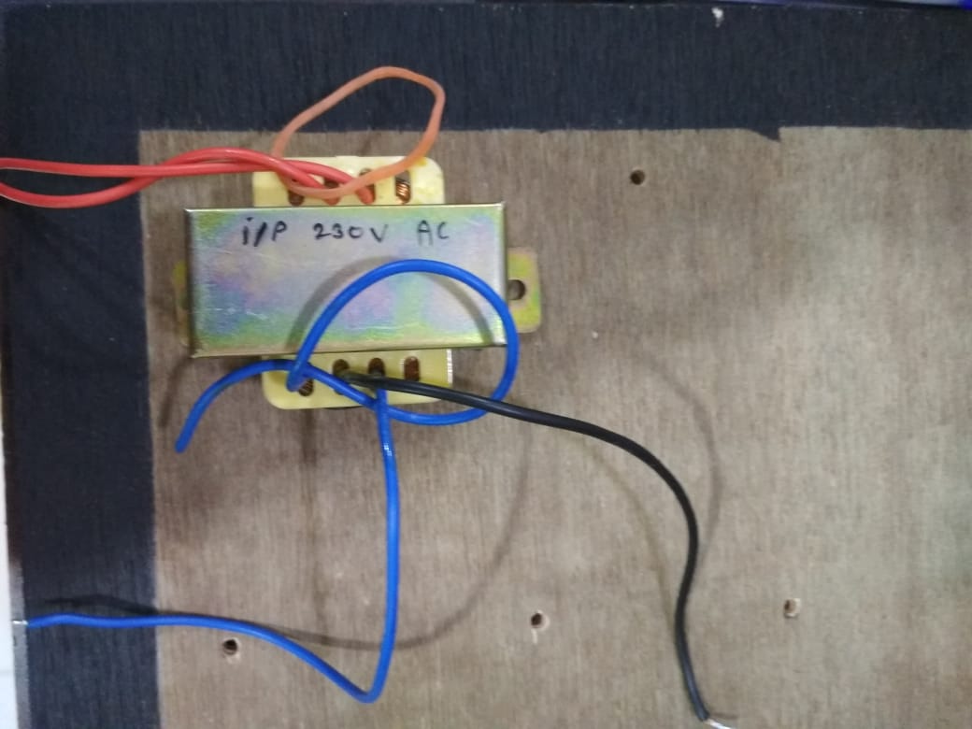
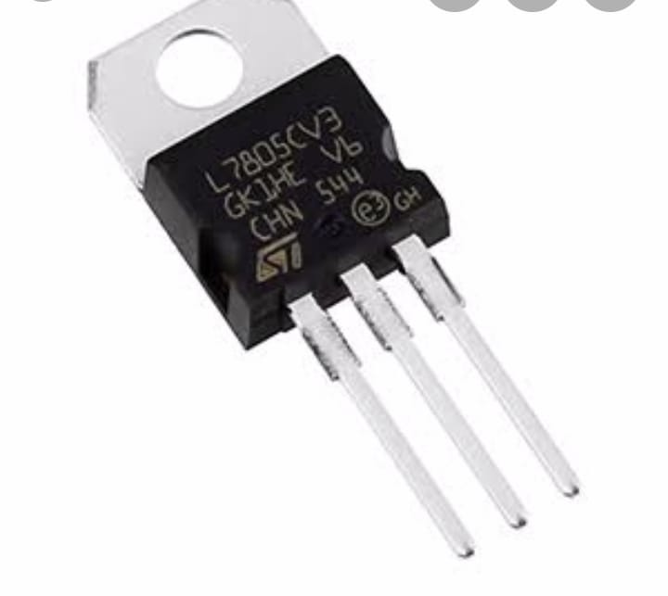
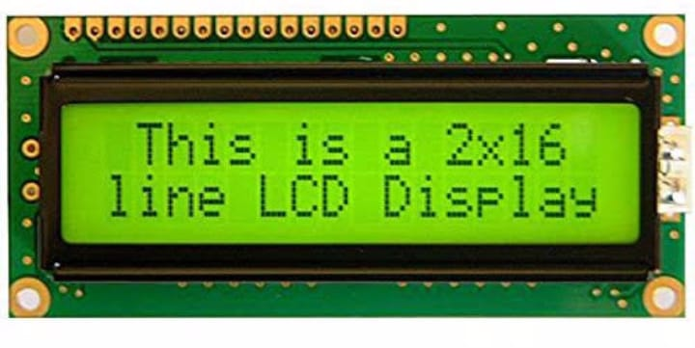
COMPONENTS
GSM
89S52
LM7805
STEP DOWN
TRANSFORMER
LCD 16*2

Slide 6
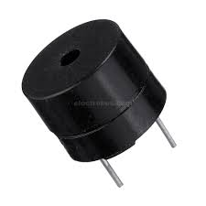
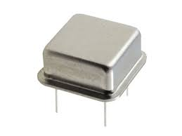
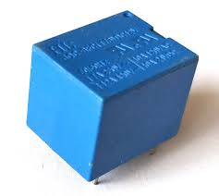
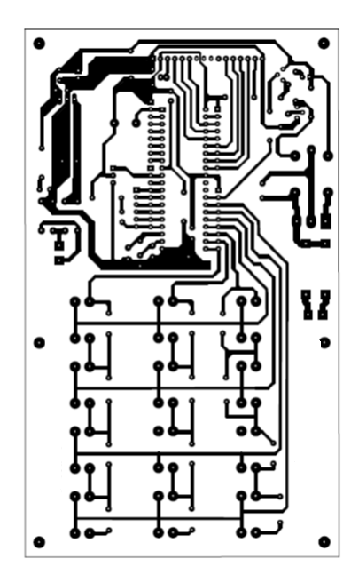
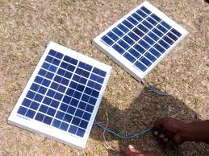
COMPONENTS
BUZZER
CRYSTAL OSCILLATOR
RELAY
SOLAR PLATE
PCB

Slide 7
BLOCK DIAGRAM OF CIRUIT:-

Slide 8
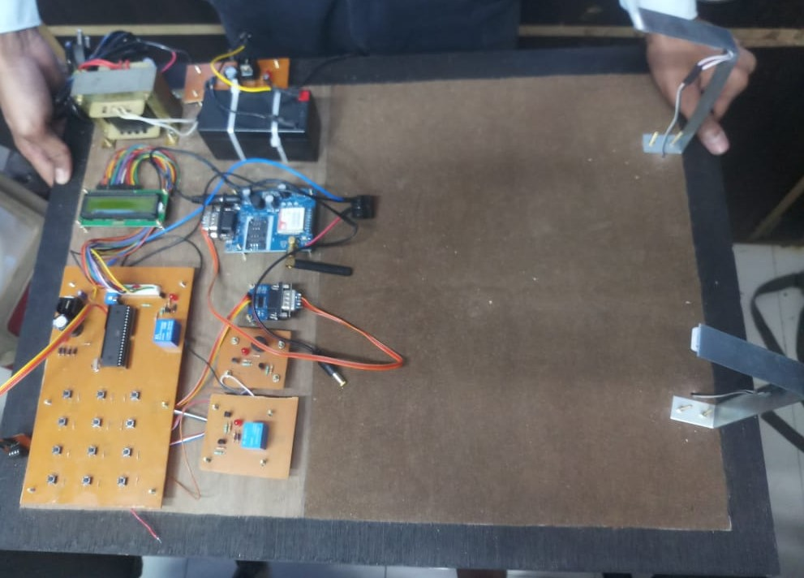
ACTUAL CIRCUIT CONSTRUCTION

Slide 9
Step down Xmer
LM3708
Capacitor
LINE 0
LCD
GSM
89S52
Buzzer
LINE 1
Relay
PCB

Slide 10
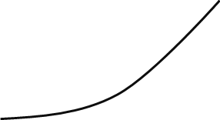
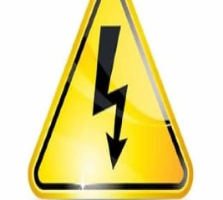
Step down Xmer
LM3708
Capacitor
LINE 0
LCD
GSM
89S52
Buzzer
LINE 1
Relay
PCB

Slide 11
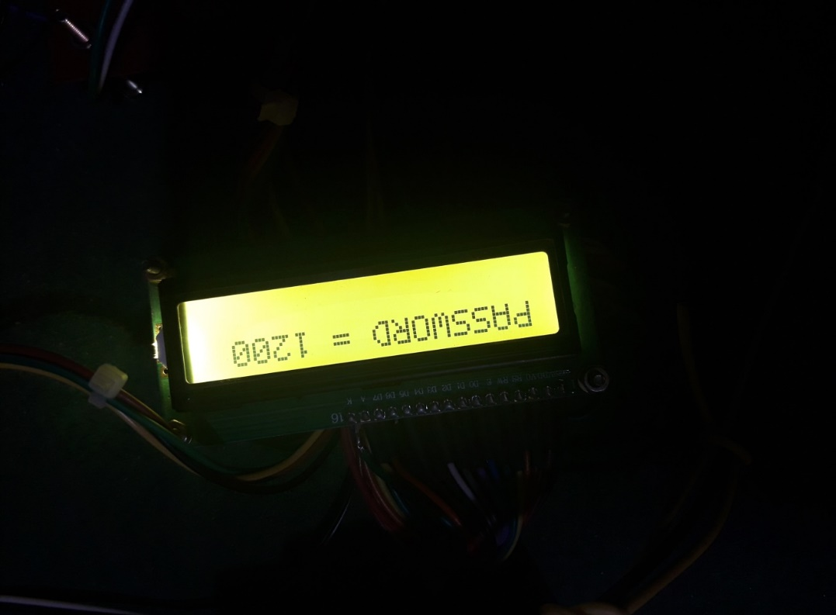
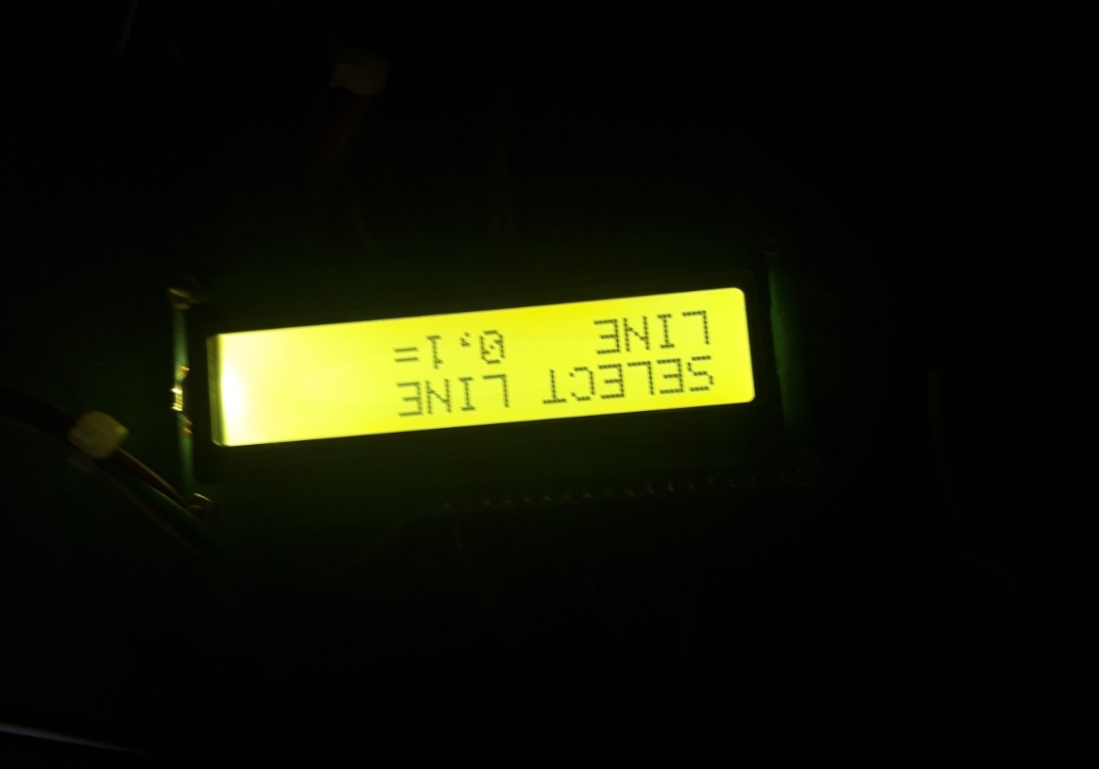
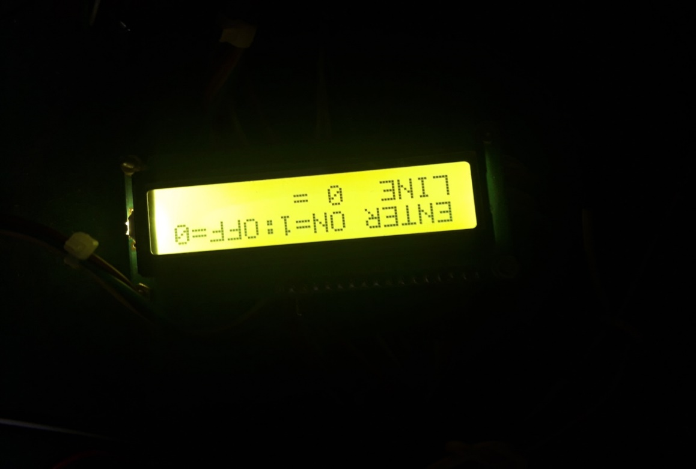

Slide 12
Step down Xmer
LM3708
Capacitor
LINE 0
LCD
GSM
89S52
Buzzer
LINE 1
Relay
PCB

Slide 13
Step down Xmer
LM3708
Capacitor
LINE 0
LCD
GSM
89S52
Buzzer
LINE 1
Relay
PCB

Slide 14
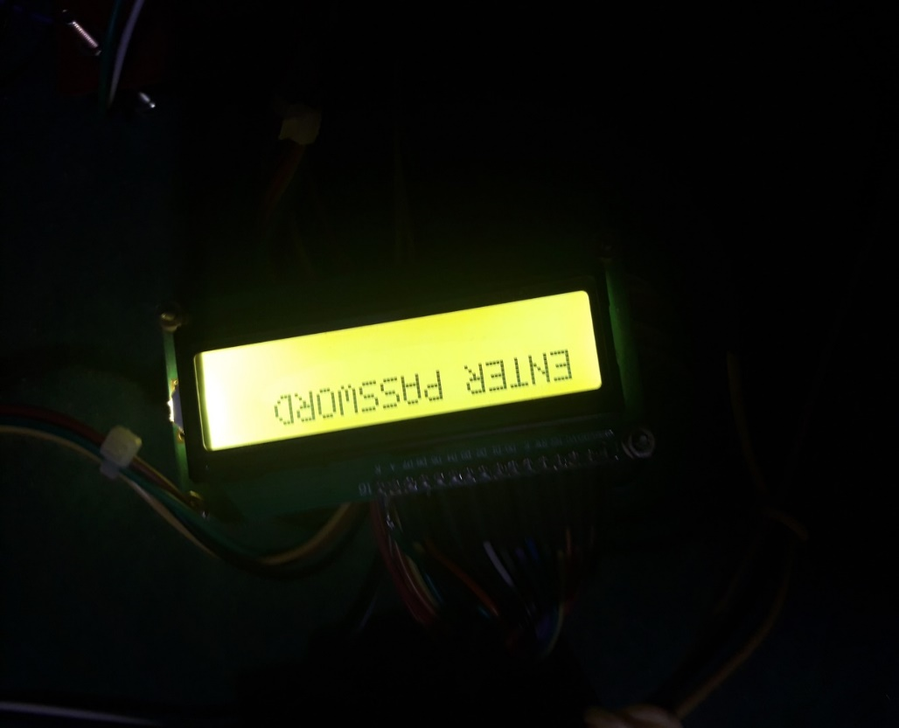

Slide 15
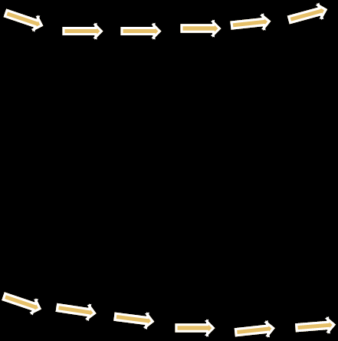
Step down Xmer
LM3708
Capacitor
LINE 0
LCD
GSM
89S52
Buzzer
LINE 1
Relay
PCB

Slide 16
ADVANTAGES:-
Machine will be secure
Unauthorized person will not able to work on the device
The important document will be safe
Our electronic door lock performed as expected. In that project was interfacing the micro controller with the hardware components. We feel that this electronic door lock is very marketable because it is easy to use, comparatively inexpensive due to low power consumption, and highly reliable.

Slide 17
DISADVANTAGES:-
The circuit is bulky.
The programming is complicated.
The circuit is complicated.
High cost
Slow speed of circuits

Slide 18
APPLICATIONS
It can be used to protect any thing
It can be used in bank locker
It can be used to turn on and off ,the industrial machines
It is used in army station
It is used for the war
It can used to control home appliances.

Slide 19
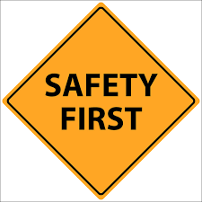
CONCLUSION
LIFE OF A PERSON HAS HIGHEST VALUE IN THE WORLD THUS IT IS VERY IMPORTANT THAT NO LIFE SHOULD GET AFFECTED DUE TO MERE MISCOMMUNICATION OR LACK OF SECURITY . SO IT IS ESSENTIAL TO TAKE POSSIBLE MEASURES TO AVOID THE ACCIDENTS . THUS THIS PROJECT CAN PROVE TO BE MOST EFFECTIVE IN ACHIEVING THIS GOAL .

Slide 20
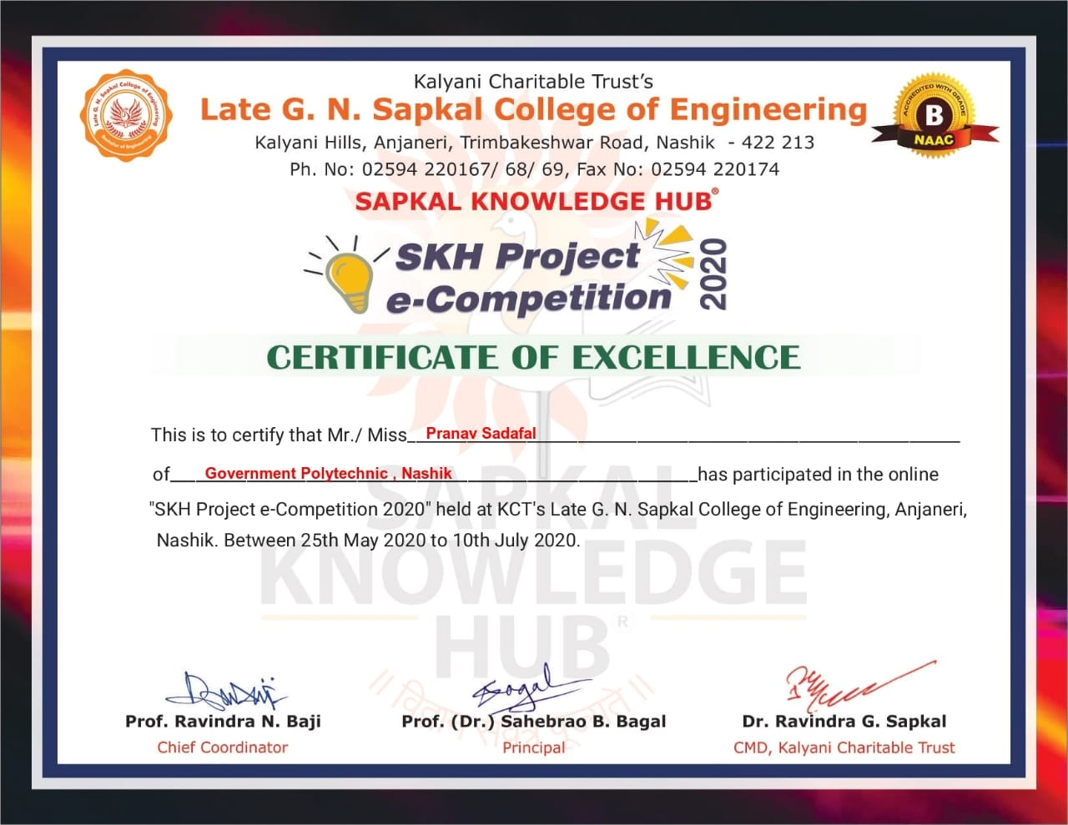
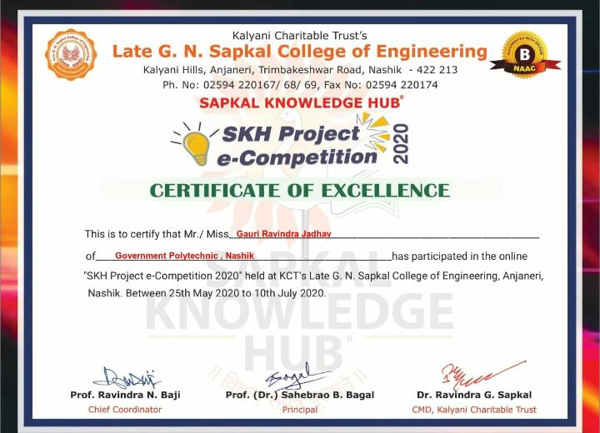
Participation in Project e-Competition

Slide 21
THANK YOU…..

